Slide 1
Price Prediction using
Neetin Verma
Long short-term memory (lstm)
Autoregressive Integrated Moving Average (arima)
GitHub Jupyter Notebook Link

Slide 2
Agenda
Objective
Data Visualization
Data Preprocessing and cleaning data
ML Model built and validation
Test set Prediction and measuring accuracy

Slide 3
Objective
The purpose of the project is to predict prediction stock price of stock using time series data.
The project also aims at building a model using LSTM & ARIMS techniques and find out the most suited predication
The data has features such as the Date, High, Open, Low, Adj Price, Volume . Models should learn from the data(Test & Train) and be able to predict the stock.

Slide 4
Long short-term memory (lstm)

Slide 5
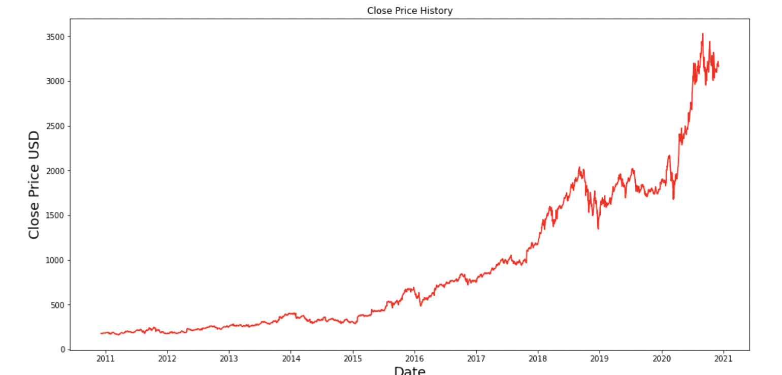
Data Visualization
Dataset has 2518 records and 6 features.
Data range from 2011 to 2021.

Slide 6
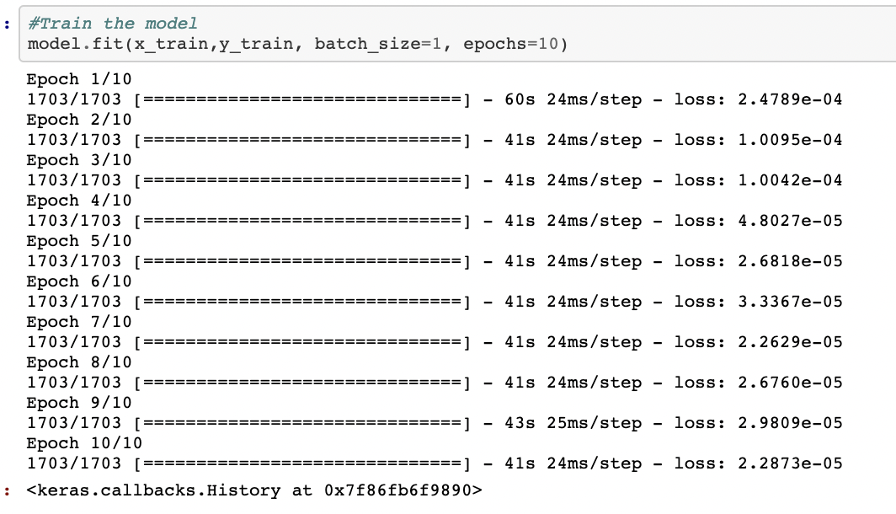
Train the dataset
Create the training dataset, Splitting the data into 70% training (1703 records) with 1 feature – “Close”
Scaled training dataset
Build the LSTM model
Train the model

Slide 7
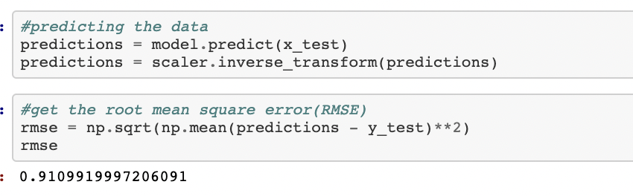
testing the dataset
Create the testing dataset, Splitting the data into 30% training (755 records) with 1 feature – “Close”
Scaled training dataset
Predict the data
Find RMSE

Slide 8
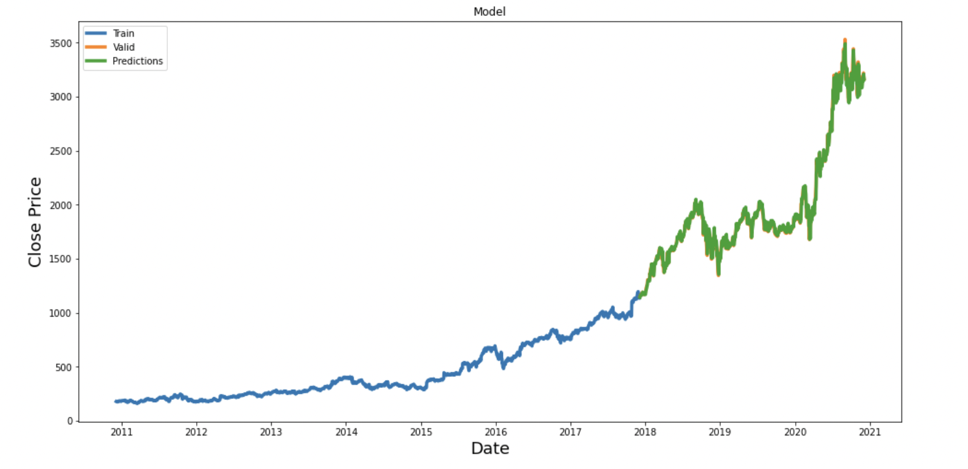
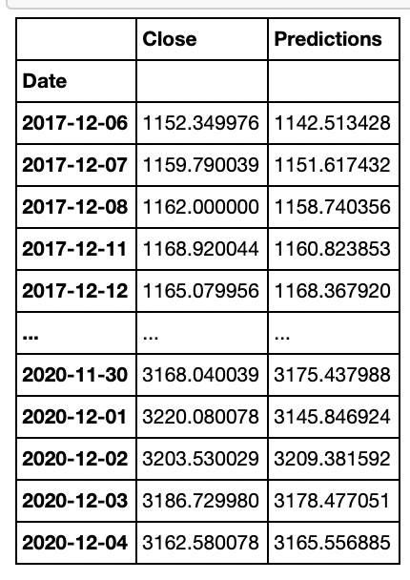
Data Visualization
Plot the Train, Valid & Prediction results.
Verify the actual close price with the prediction/model outcome.

Slide 9
ARIMA - The AutoRegressive Integrated Moving Average (ARIMA) model

Slide 10
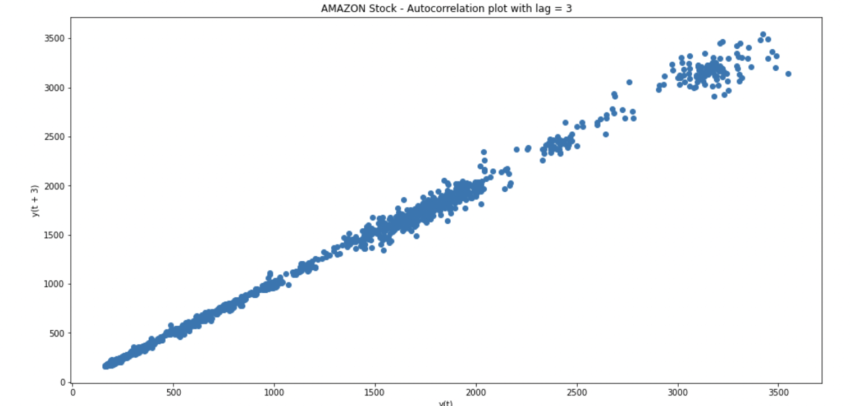
Data VISUALIZATION
Checking cross-correlation in our data.
We can now confirm that ARIMA is going to be a good model to be applied to this type of data (there is auto-correlation in the data).

Slide 11
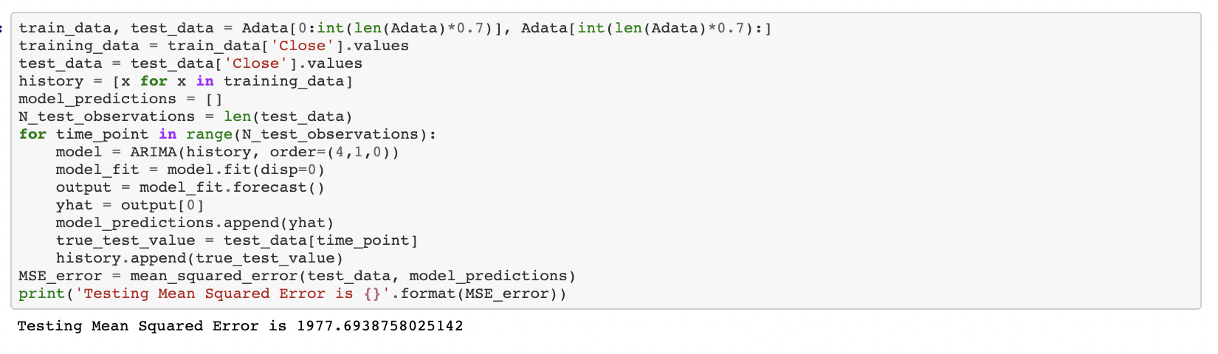
TRAIN(70%) & TEST(30%) THE DATA
ARIMA parameters: p=4, d=1 and q=0.
The MSE of the test set is quite large denoting that the precise prediction is a hard problem. However, this is the average squared value across all the test set predictions.

Slide 12
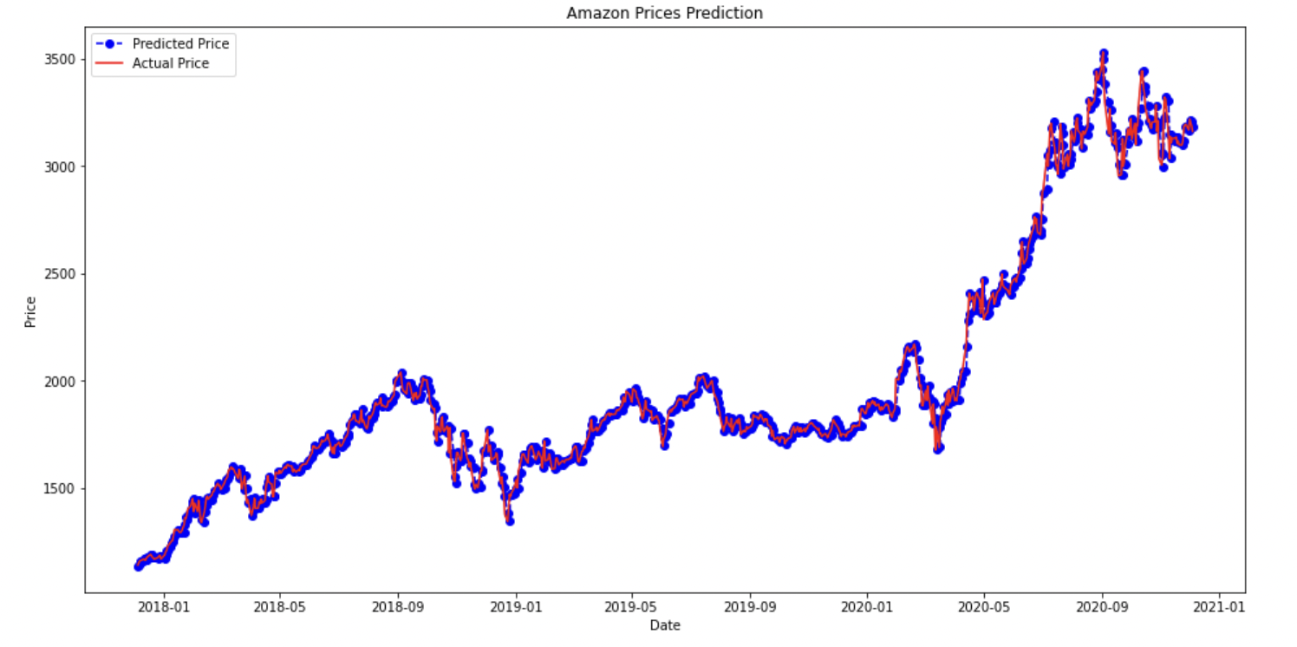
ARIMA model performance on the test set

Slide 13
CONCULSION
Our ARIMA model results are more appreciable.
This model offers a good prediction accuracy and to be relatively fast compared to LSTM, in terms of training/fitting time and complexity.

